Slide 1
POLS 207 State & Local Government*
Chapter 9A
The Culture of State Legislatures
Dr. Roblyer, Ph.D.
*These slides are based on originals provided by Dr. Harvey Tucker

Slide 2
Learning Objectives
Characterize the presence and type of legislatures across the US states.
Explain why conservative legislators might see advantages in signing the Taxpayer Protection Pledge. Also explain the potential downsides.
Describe how the Game of Chicken from game theory illustrates the concept of tying hands as a winning strategy. Connect this concept to the Taxpayer Protection Pledge.
List the high-level functions of a state legislature.
Discuss how state legislatures might be seen as an ideal form of representative government, or at least as more ideal than the US Congress.
Explain what Dave McNeely said about the legislative system, the value of a legislator, the role of expertise, and the threat of supermajorities.

Slide 3
Legislative Branch
All state governments have legislatures
Nebraska has only unicameral in U.S.
Representation function rooted in revolutionary cry “No taxation without representation!”
Today’s cry: “Representation without taxation!”
Grover Norquist’s Taxpayer Protection Pledge signed by 35 (down from 49 3yrs ago) of 150 current Texas House members
www.tamupress.com
http://www.atr.org/pledge-database

Slide 4
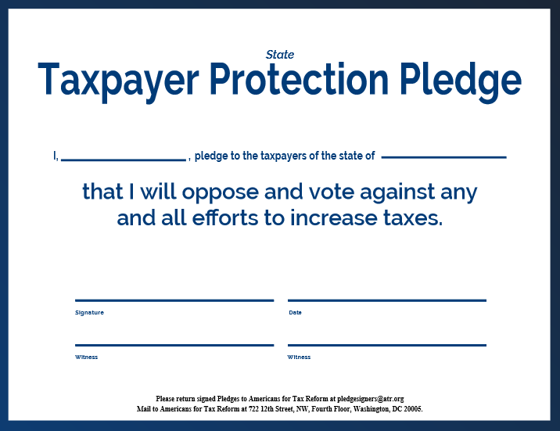
Americans for Tax Reform
http://www.atr.org/
766 state legislators and 11 governors have signed nationally
No exceptions permitted (although “tax” can be redefined!)
Down side: Can generate extreme pressure from constituents & other signers to keep this pledge, independent of circumstances
Up side: Effectively keeps signers from giving in during tax discussions
For signers

Slide 5

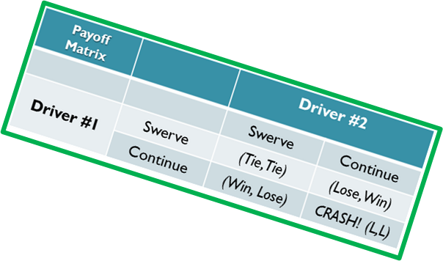
Game Theory’s “Game of Chicken”
?
?

Slide 6
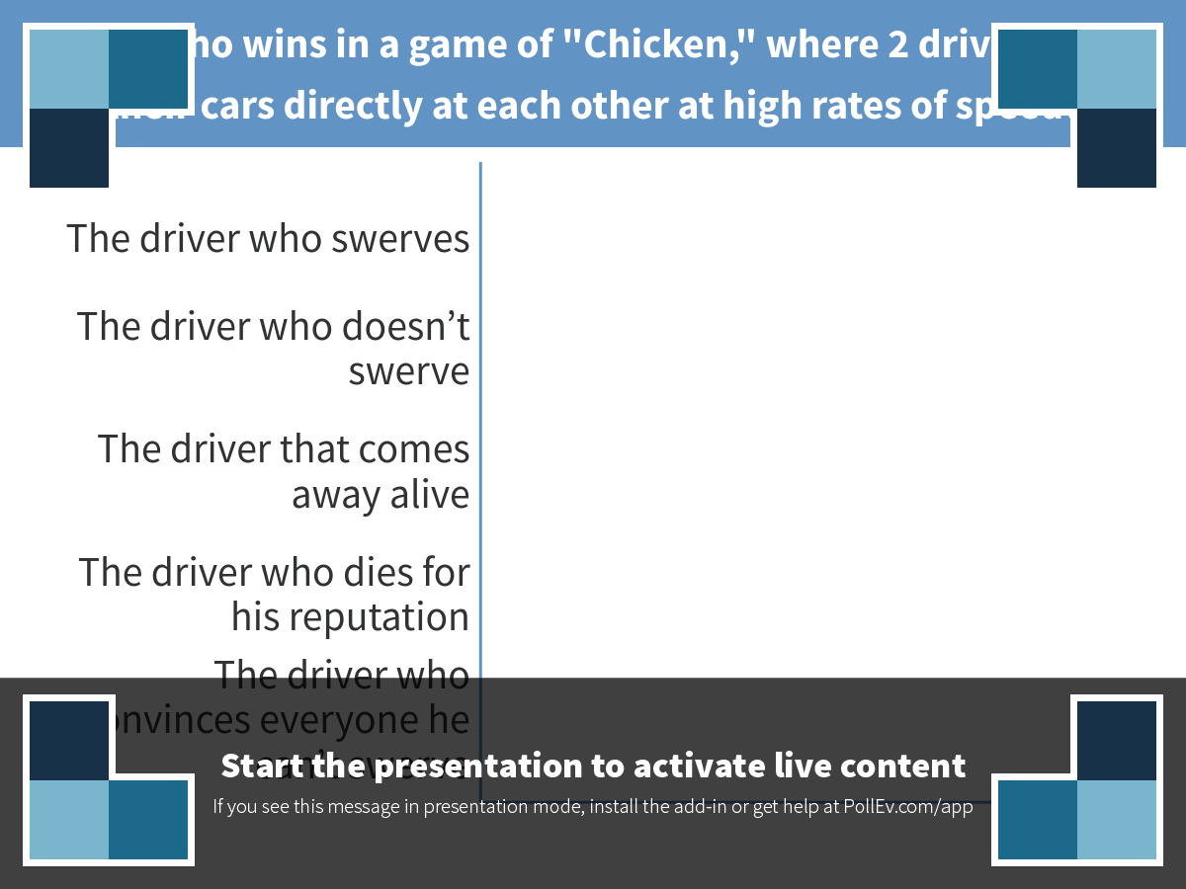
Notes:
Poll Title: POLL: Who wins in a game of "Chicken," where 2 drivers drive their cars directly at each other at high rates of speed? https://www.polleverywhere.com/multiple_choice_polls/t3D31ugKkSS9O12

Slide 7
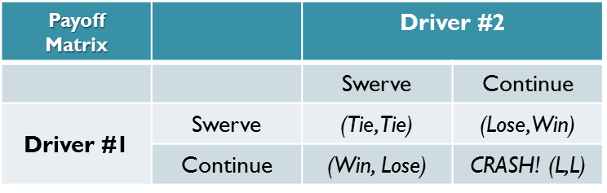
Americans for Tax Reform
http://www.atr.org/
766 state legislators and 11 governors have signed nationally
Note no exceptions permitted (although “tax” can be redefined!)
Down side: Can generate extreme pressure from constituents & other signers to keep this pledge, independent of circumstances
Up side: Effectively keeps signers from giving in during tax discussions
“Tying hands” is a winning strategy for a game of “chicken” in game theory
For signers
Driver #1 always wins if she tosses her steering wheel out the window, ensuring that Driver #2 sees her do it.

Slide 8
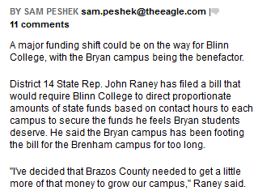
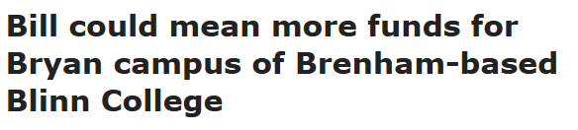
Legislatures’ Functions
Make statutory laws (or “Pass statutes”)
Some intended to solve problems, others are symbolic or honorific (or favors)
Amend state constitutions
“Service” constituents
Bring government funding to their districts
More money = more secure seat?
…What does this mean?
http://www.theeagle.com/news/local/bill-could-mean-more-funds-for-bryan-campus-of-brenham/article_a988c73d-b23f-564c-a0df-b26f3a0d030a.html

Slide 9
Are State Legislatures the Ideal Representative Government?
Members are “sent” by much smaller constituencies than in Congressional elections
Legislatures remain largely lay bodies
Representatives at this level more like “regular folks” than at national level
…Yet, most state residents don’t understand how their legislature really works

Slide 10
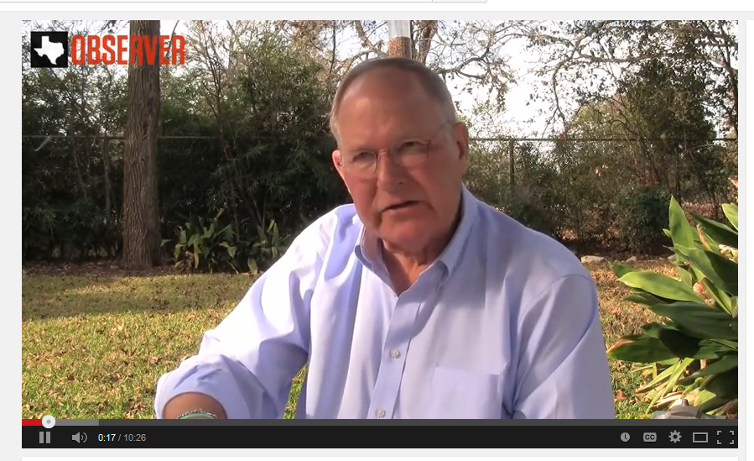
“Dean” of Texas capitol press corps on Texas legislative culture
Dave McNeely
Began covering Texas politics in 1960s
https://youtu.be/axDD9a8lrws
(0:00-4:32, remainder optional)
“Dog Catches Bus” segment (starts at 2:25) is about the implications of the 1st super majority that Republicans had built by 2011 within the Texas State House since they became the majority party in 2002.
Notes:
Backup link to video:
http://www.youtube.com/watch?v=K_y0FduR1pY

Slide 11
Takeaway Points from McNeely
Important to view legislature as a system with a unique culture
Value of a legislator is how many votes he/she can bring to bear for the party or cause
Reliance on expertise of others is routine and necessary
Supermajorities (that vote as a block) mean the party in power doesn’t need the other party to govern
Keep the idea of “Legislature as a system” in mind throughout this chapter…

Slide 12
Understanding Check Do this activity to begin mastering this material
Coming up next…

